Slide 1
Popular holiday destinations in Georgia and Leisure Activities
Mariam Anjaparidze

Slide 2
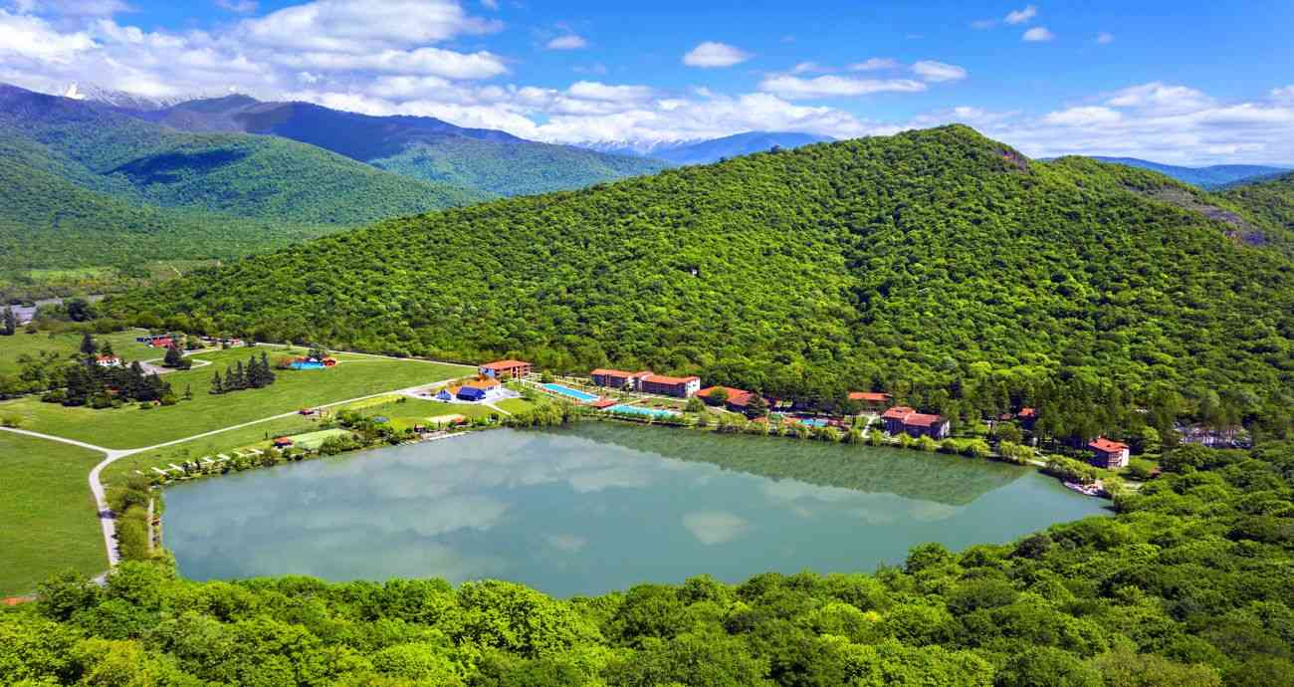
Lopota Lake Resort
Lopota lake Resort is one of the popular holiday destination’s in Georgia, which is located in Kakheti region and surrounded by the Caucasus mountains.

Slide 3
We engage our youngest guests at every turn, inspiring kids to interact with their environment and try something exciting. To find a place for all the fun at Lopota, we have created kids’ club - a space for little explorers and are ready to join them for adventures. Our professional nannies will keep the children entertained and help you to make the most of your stay.
Lopota Resort offers its guests a variety of entertainment options. Leisure facilities include bicycles and water bikes, billiards, table football, tennis and mini-golf. Lopota Resort also provides horse-riding tours in Lopota Valley, where guests have an opportunity to ride horses of a high breed while enjoying the beautiful natural scenery of the Kakheti region. Only Lopota Resort offers you the largest swimming venue.

Slide 4
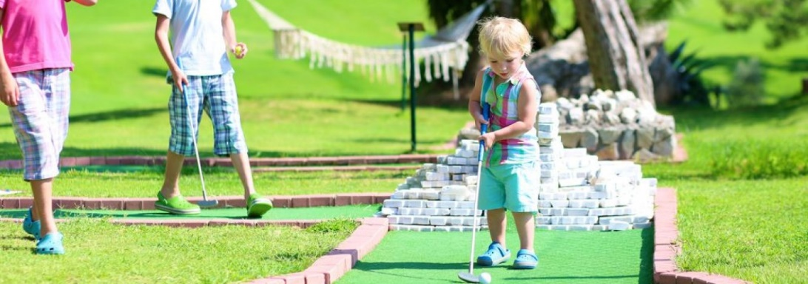
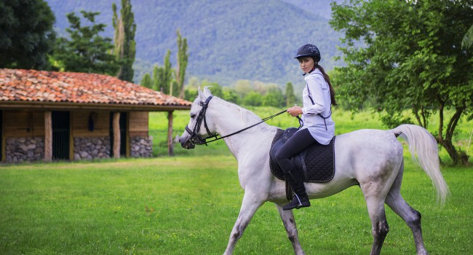
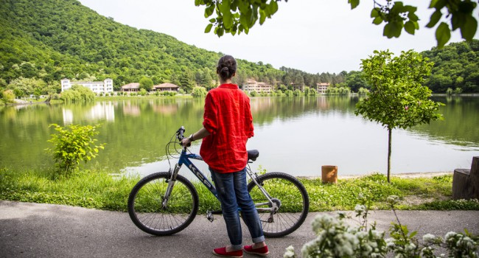
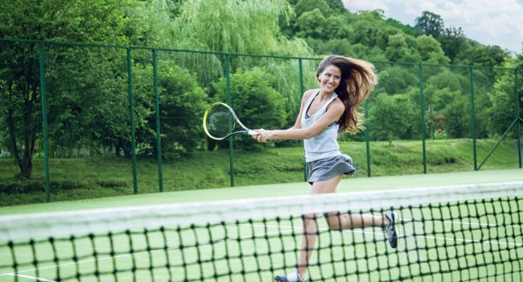
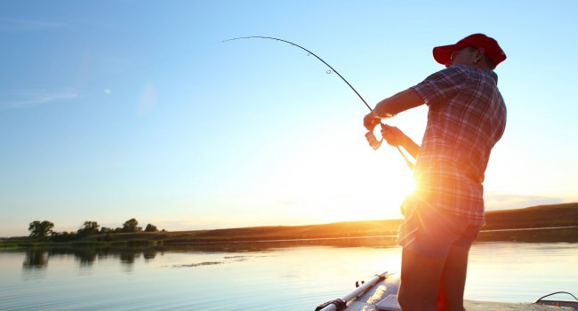
Lopota Lake Resort & Spa organizes annual 4-day corporate championship between amateur players. During the rest of the year, any guest can test their abilities on 2 professional courts.
Mini golf is one of the most amusing things you can do at Lopota Resort. The rules are simple and anyone can play, so don’t be shy!

